Slide 1









PRESENGTING BY:
KATANKUR UDAY KUMAR
21CS002386
INTERNSHIP PROJECT REPORT (mid-term)
SUBMITTED TO:
Mr. ARUN VAISHNAV
Ms. POONAM SAINI

Slide 2


Slide 3



Manager supervising the internship project:
Name: RAM KUMAR M
Designation :MANAGER
Email:ramkumar@edvedha.com Mobile No: 8074820377
Faculty mentors
Name: Ms. Poonam Saini
Designation :PROFESSOR
ORGANIZATION: EdVedha private Limited
INTERNSHIP DURATION: Jan To JULY

Slide 4


problem statement :
User Type: Students Feeling Overwhelmed by Student Loan Information
Students often find it difficult to navigate the complex world of student loans, repayment options, and financial aid, leading to confusion and anxiety about their future debt. An app that simplifies this information and offers personalized guidance could greatly assist them.

Slide 5

Mallow Technologies
Problem Statement
A firm which has n number of employees and projects. For each project, they need several groups to discuss related development, project management and deployment. Having several groups is hard to maintain when they work on multiple projects.
What he requires?
They need a Business chatting tool similar to Slack and Teams.
User should able to do individual and Group chat based on projects.
In the Individual and Group Chat, there will be having following options.
Chat option is mandatory
Both sender and recipient can attach the media's like image, video, audio, pdf's, docs, etc..
From the Individual and Group, user can initiate the normal and video call.
In Group, user can mention another user in the chat(this need to be differentiated)
Need to show the differentiation between private and public group.
Need an option mark the individual user chat and Group to their favourite list
In individual profile, It has Profile pic, last seen, attachments details, and their social media links, Shortcut to chat, pinned/starred chats.
In group chat profile, we need to show the list of users in that group, admin user’s, pinned/starred chats
There must need to have a notification center, In that mentioned chats, missed video and audio call.

Slide 6
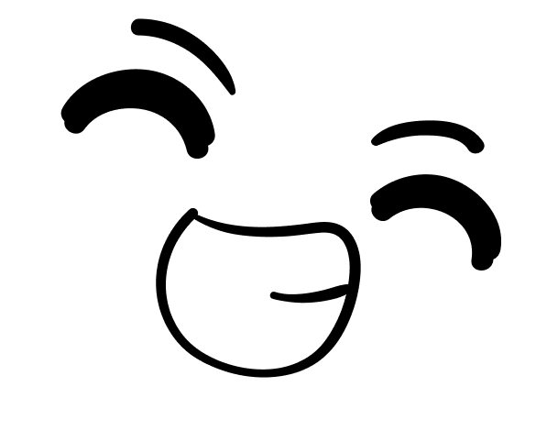




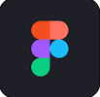
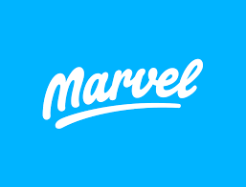




Tools Used
Figma
Adobe XD
Diagram.io
Marvel
Behance
Excel
.

Slide 7




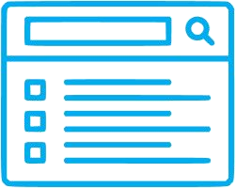

Design Process
DESIGN THINKING
Discover
Problem Statement
Empathize
Quantitative Research
Define
Empathy Mapping
Ideate
User Story
Prototype
Sketching a Wireframe
Test
Feedback from Team
Ideation Workshop
User Journey
Qualitative Research
Create Personas
Prototype in Prottapp
Usability test using Maze.co
Scope Document
Information Architecture
User ﬂow / Task ﬂow

Slide 8


PROJECT METHODOLOGY
PRODUT THINKING
User Journey
empathy Mapping
Quantitative Research
Qualitative Research
User Persona
Ideation techniques and User stories
User Centric Scope document
Card sorting
User Flow
wireframes
Prototype
UI designing

Slide 9
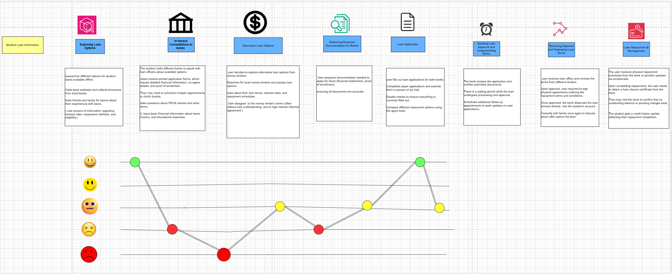


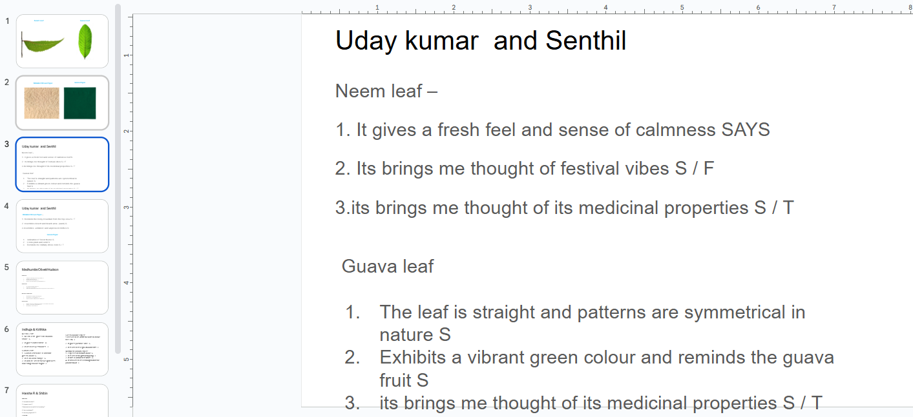
My Progress So Far
Till User flow completed
User Journey
EMPATHY MAPPING-(SAYS, DOES,THINK,FEELS STATEMENTS)

Slide 10
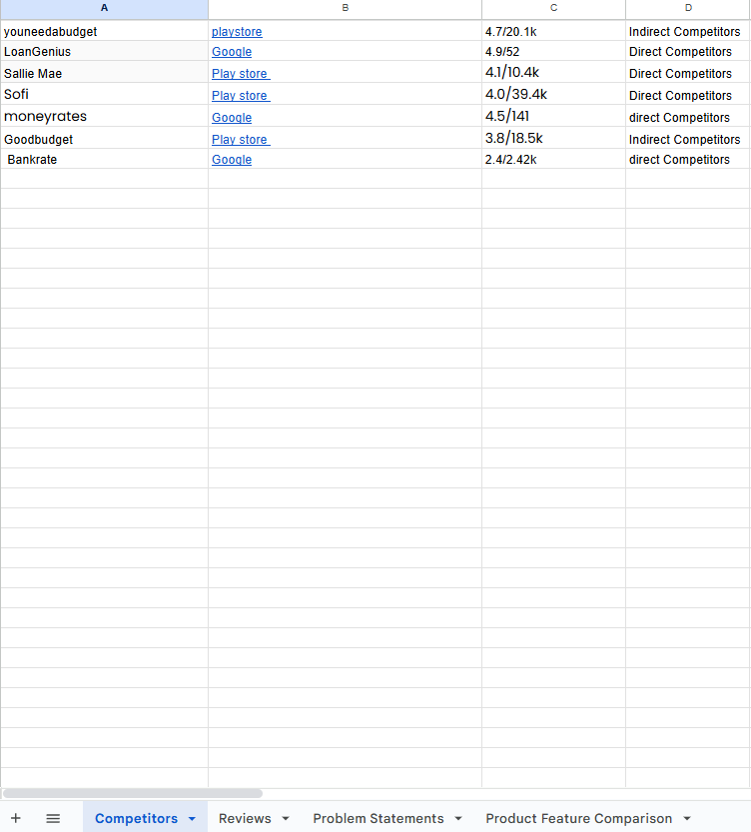
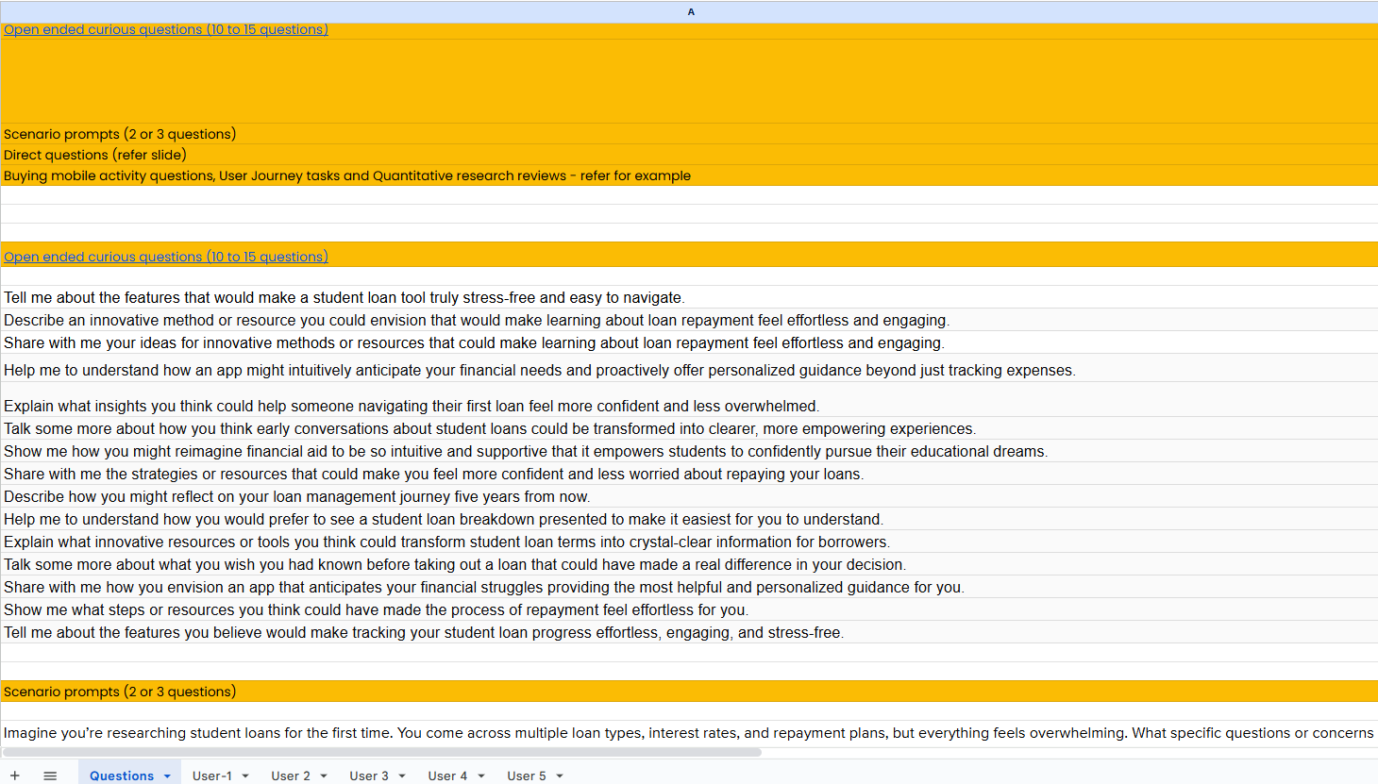
My Progress So Far
Quantitative RESEARCH
Competitors
Reviews
Problem Statements
Product Feature Comparison
QUALITATIVE RESEARCH
FOR 5 USERS

Slide 11
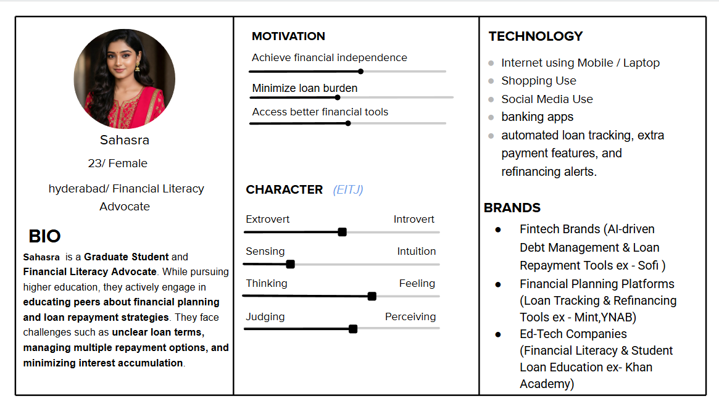
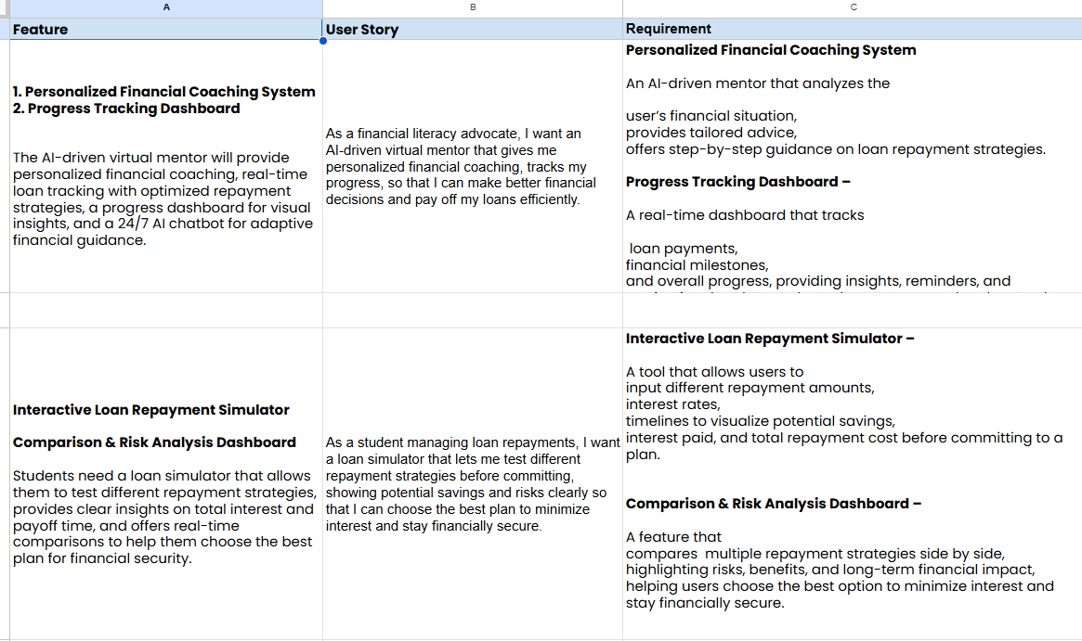
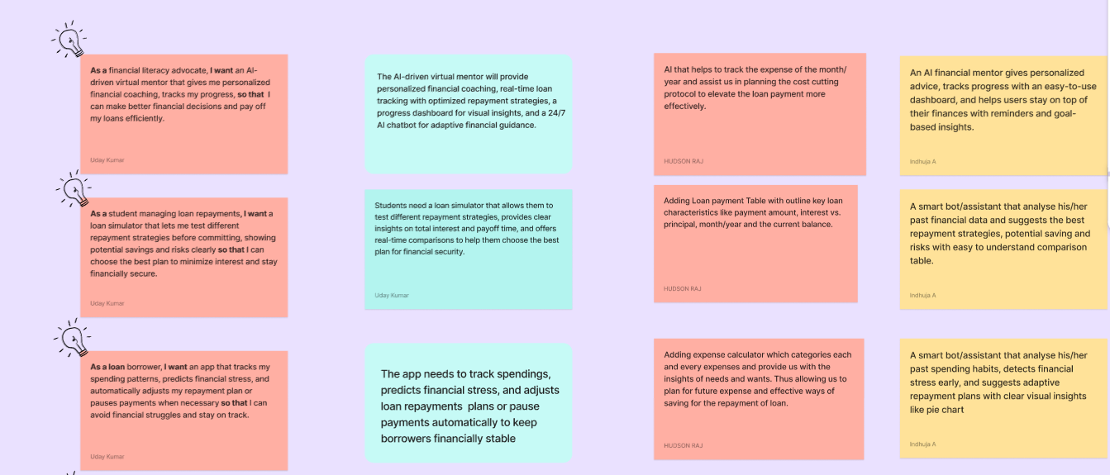
User persona of 5 users
User Centric Scope document
Ideation techniques and User stories

Slide 12
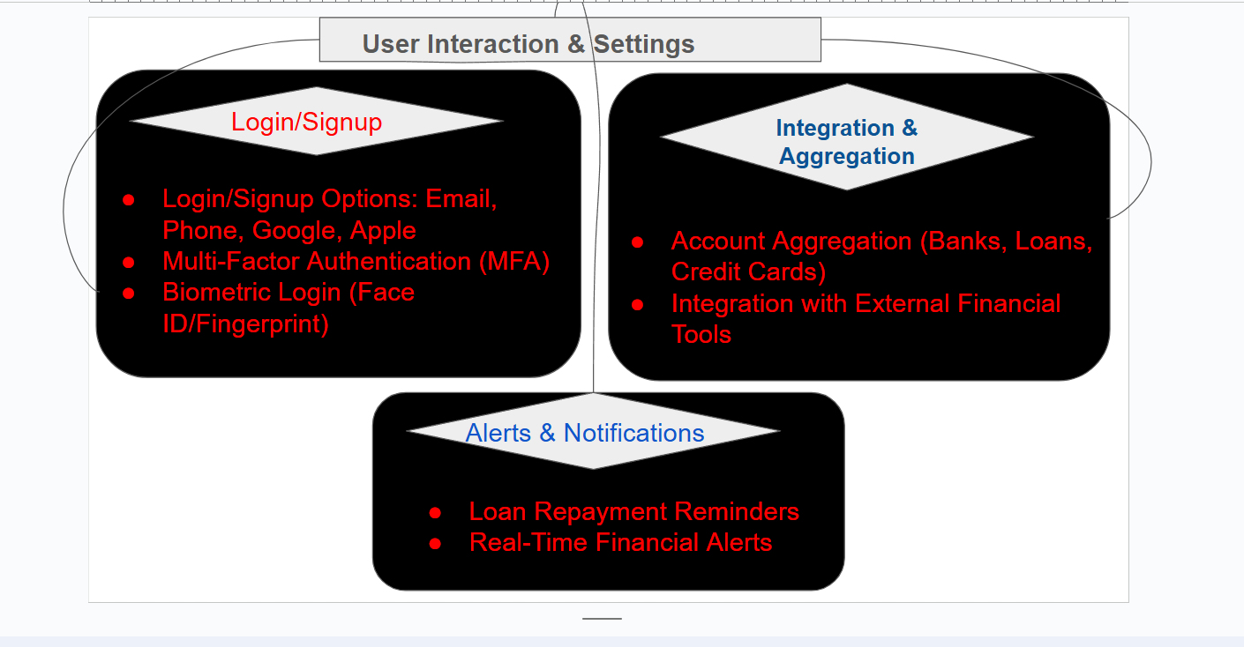
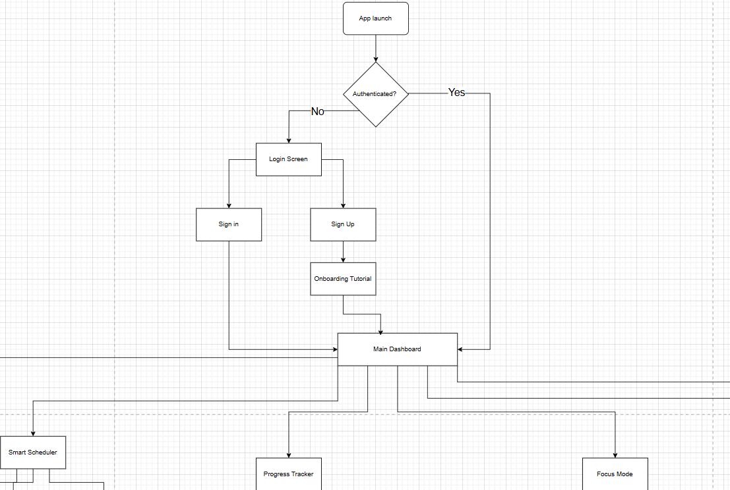
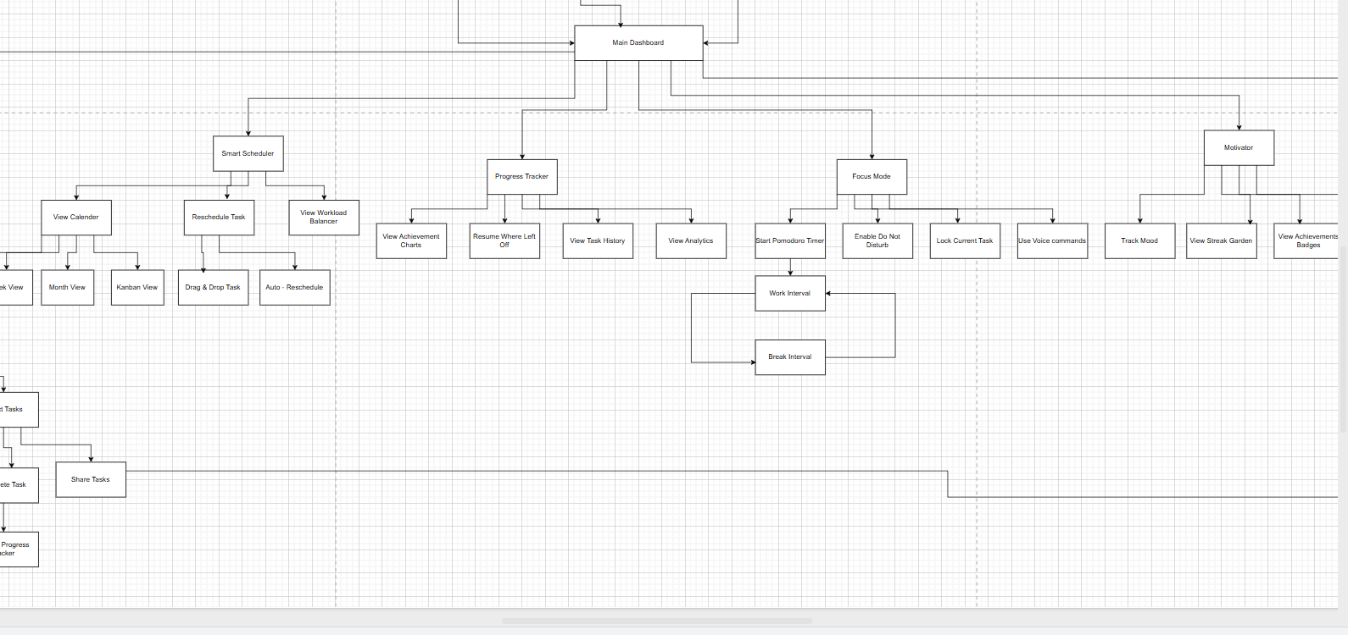

USER FLOW CHART
CARD SORTING

Slide 13
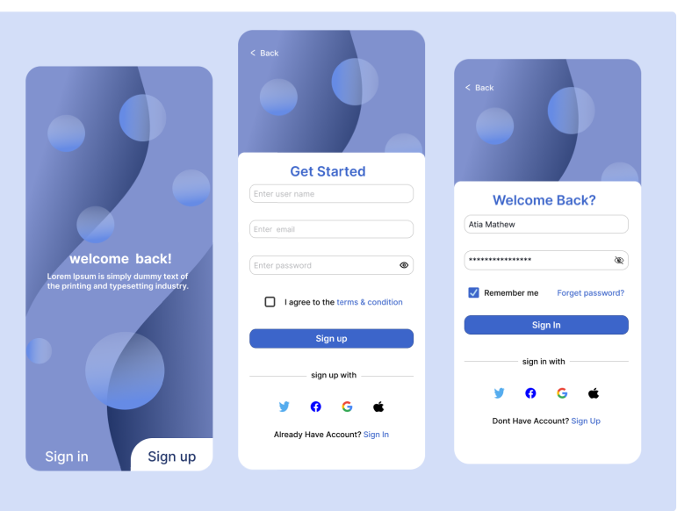
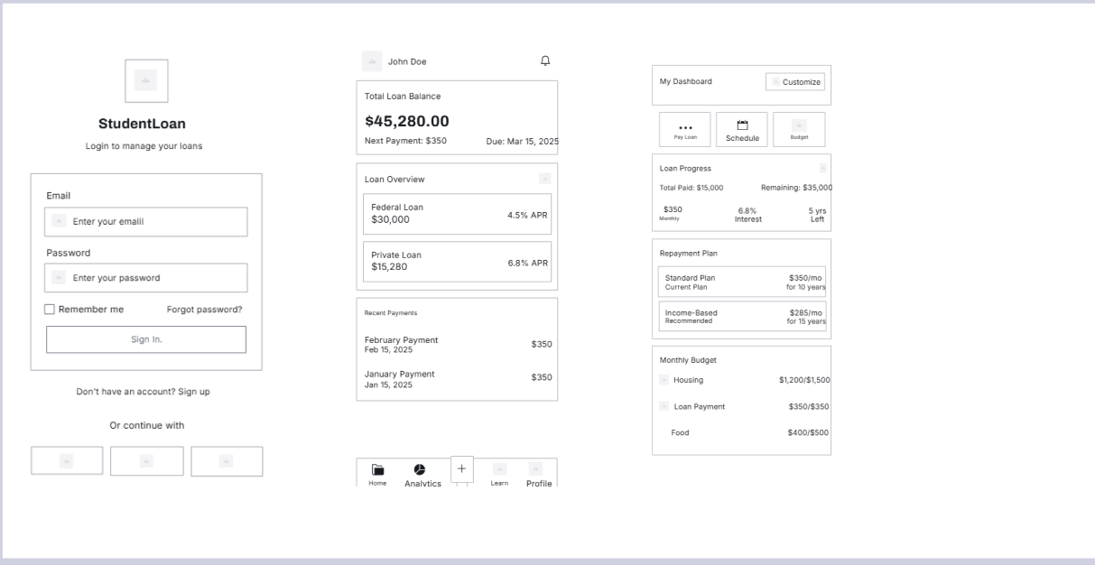


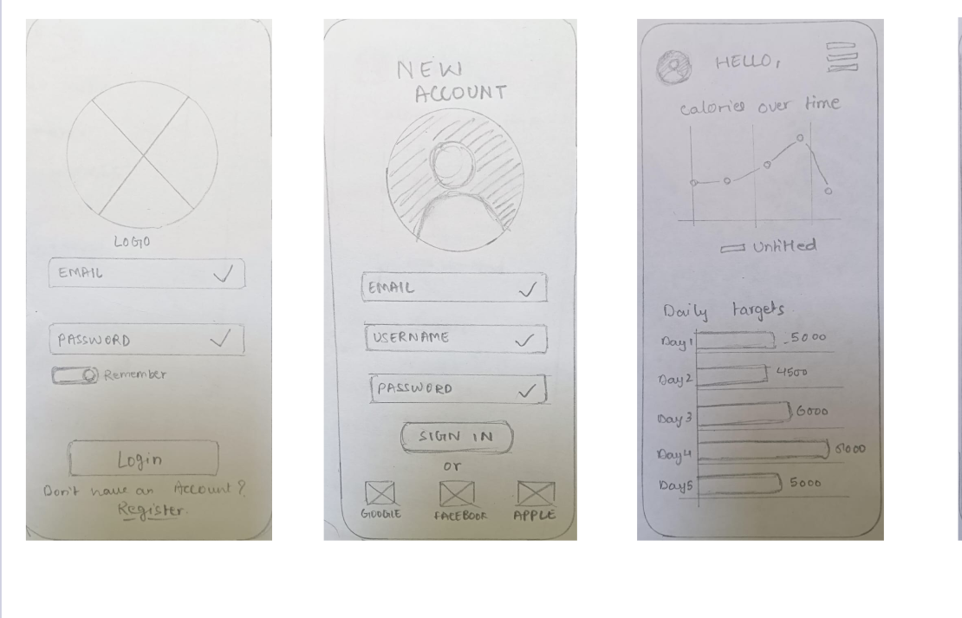
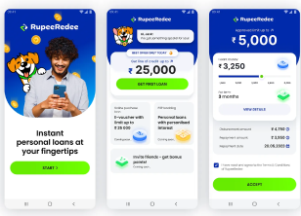


Slide 14
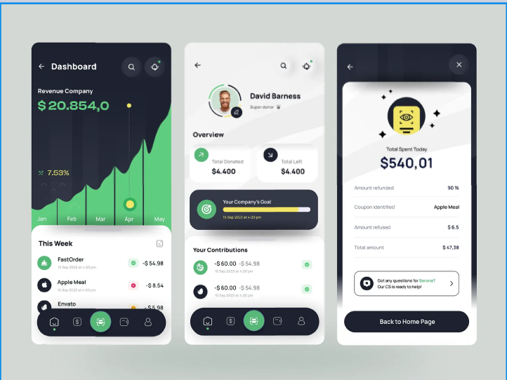
Ongoing Work and Next Steps
Designing the UI prototypes for my project problem statements USING FIGMA,ADOBE XD…………
UNTIL END OF MAY 2025
PROBLEMS THAT ARE CHALLENING TO FACE
(CRAP: Contrast, Repetition, Alignment, Proximity).

Slide 15
What I've Learned
Design Thinking Process
Mastering the 5 stages: Empathize, Define, Ideate, Prototype, and Test.
Wireframing & Prototyping
Creating low-fidelity wireframes for layout ideas.
Building interactive prototypes using tools like Figma, Adobe XD
Visual Design Principles
Applying CRAP principles (Contrast, Repetition, Alignment, Proximity).
Understanding color theory, typography, spacing, and iconography.
Perfection with Figma and Adobe xd

Slide 16


CONCLUSION

Slide 17

My experience so far at EdVedha Private limited has been both enriching and inspiring. Working closely with a talented team has helped me develop a deeper understanding of user-centered design, practical UI/UX workflows, and real-world client expectations. I’ve gained hands-on experience in wireframing, prototyping, conducting user research, and collaborating with developers to bring ideas to life. The supportive work environment and guidance from mentors have truly boosted my confidence and skill set.

Slide 18
Motivation and Commitment
I'm highly motivated to continue growing and contributing meaningfully during the remaining internship period. I’m eager to take on new challenges, further refine my design skills, and make a positive impact on upcoming projects. My goal is to end this internship with a strong foundation, not only in UI/UX design, but also in teamwork, creativity, and delivering user-focused solutions.

Slide 19
THANK YOU

